Slide 1
Combining Data from Multiple Tables
SQL uses set operators to combine tables vertically.
This produces results that can be compared to a
DATA step concatenation.
Table A
Table B

Slide 2
Combining Data from Multiple Tables
SQL uses joins to combine tables horizontally.
This produces results that can be compared to a
DATA step merge.
Table A Table B

Slide 3
Types of Joins
PROC SQL supports two types of joins:
  inner joins
  outer joins

Slide 4
Types of Joins
Inner joins
  return only matching rows
  enable a maximum of 256 tables to be joined
  at the same time.

Slide 5
Types of Joins
Outer joins
  return all matching rows, plus nonmatching rows
  from one or both tables
  can be performed on only two tables or views
  at a time.
Left
Full
Right

Slide 6
Cartesian Product
To understand how SQL processes a join, it is important to understand the concept of the Cartesian product.
A query that lists multiple tables in the FROM clause without a WHERE clause produces all possible combinations of rows from all tables. This result is called the Cartesian product.
select *
from one, two;
s105d01
Notes:
s105d01

Slide 7
Cartesian Product
Table One
X | A
1 | a
4 | d
2 | b
Table Two
X | B
2 | x
3 | y
5 | v
s105d01
...

Slide 8
Cartesian Product
Table One
X | A
1 | a
4 | d
2 | b
Table Two
X | B
2 | x
3 | y
5 | v
Result Set
X | A | X | B
1 | a | 2 | x
s105d01
...

Slide 9
Cartesian Product
Table One
X | A
1 | a
4 | d
2 | b
Table Two
X | B
2 | x
3 | y
5 | v
Result Set
X | A | X | B
1 | a | 2 | x
1 | a | 3 | y
s105d01
...

Slide 10
Cartesian Product
Table One
X | A
1 | a
4 | d
2 | b
Table Two
X | B
2 | x
3 | y
5 | v
Result Set
X | A | X | B
1 | a | 2 | x
1 | a | 3 | y
1 | a | 5 | v
s105d01
...

Slide 11
Cartesian Product
Table One
X | A
1 | a
4 | d
2 | b
Table Two
X | B
2 | x
3 | y
5 | v
Result Set
X | A | X | B
1 | a | 2 | x
1 | a | 3 | y
1 | a | 5 | v
4 | d | 2 | x
s105d01
...

Slide 12
Cartesian Product
Table One
X | A
1 | a
4 | d
2 | b
Table Two
X | B
2 | x
3 | y
5 | v
Result Set
X | A | X | B
1 | a | 2 | x
1 | a | 3 | y
1 | a | 5 | v
4 | d | 2 | x
4 | d | 3 | y
s105d01
...

Slide 13
Cartesian Product
Table One
X | A
1 | a
4 | d
2 | b
Table Two
X | B
2 | x
3 | y
5 | v
Result Set
X | A | X | B
1 | a | 2 | x
1 | a | 3 | y
1 | a | 5 | v
4 | d | 2 | x
4 | d | 3 | y
4 | d | 5 | v
s105d01
...

Slide 14
Cartesian Product
Table One
X | A
1 | a
4 | d
2 | b
Table Two
X | B
2 | x
3 | y
5 | v
Result Set
X | A | X | B
1 | a | 2 | x
1 | a | 3 | y
1 | a | 5 | v
4 | d | 2 | x
4 | d | 3 | y
4 | d | 5 | v
2 | b | 2 | x
s105d01
...

Slide 15
Cartesian Product
Table One
X | A
1 | a
4 | d
2 | b
Table Two
X | B
2 | x
3 | y
5 | v
Result Set
X | A | X | B
1 | a | 2 | x
1 | a | 3 | y
1 | a | 5 | v
4 | d | 2 | x
4 | d | 3 | y
4 | d | 5 | v
2 | b | 2 | x
2 | b | 3 | y
s105d01
...

Slide 16
Cartesian Product
Table One
X | A
1 | a
4 | d
2 | b
Table Two
X | B
2 | x
3 | y
5 | v
Result Set
X | A | X | B
1 | a | 2 | x
1 | a | 3 | y
1 | a | 5 | v
4 | d | 2 | x
4 | d | 3 | y
4 | d | 5 | v
2 | b | 2 | x
2 | b | 3 | y
2 | b | 5 | v
s105d01
...

Slide 17
Cartesian Product
Table One
X | A
1 | a
4 | d
2 | b
Table Two
X | B
2 | x
3 | y
5 | v
Result Set
X | A | X | B
1 | a | 2 | x
1 | a | 3 | y
1 | a | 5 | v
4 | d | 2 | x
4 | d | 3 | y
4 | d | 5 | v
2 | b | 2 | x
2 | b | 3 | y
2 | b | 5 | v
s105d01

Slide 18
Cartesian Product
Table One
X | A
1 | a
4 | d
2 | b
Table Two
X | B
2 | x
3 | y
5 | v
3 rows
Result Set
X | A | X | B
1 | a | 2 | x
1 | a | 3 | y
1 | a | 5 | v
4 | d | 2 | x
4 | d | 3 | y
4 | d | 5 | v
2 | b | 2 | x
2 | b | 3 | y
2 | b | 5 | v
...

Slide 19
Cartesian Product
Table One
X | A
1 | a
4 | d
2 | b
Table Two
X | B
2 | x
3 | y
5 | v
3 rows
3 rows
Result Set
X | A | X | B
1 | a | 2 | x
1 | a | 3 | y
1 | a | 5 | v
4 | d | 2 | x
4 | d | 3 | y
4 | d | 5 | v
2 | b | 2 | x
2 | b | 3 | y
2 | b | 5 | v
...

Slide 20
Cartesian Product
Table One
X | A
1 | a
4 | d
2 | b
Table Two
X | B
2 | x
3 | y
5 | v
3 rows
X
3 rows
Result Set
X | A | X | B
1 | a | 2 | x
1 | a | 3 | y
1 | a | 5 | v
4 | d | 2 | x
4 | d | 3 | y
4 | d | 5 | v
2 | b | 2 | x
2 | b | 3 | y
2 | b | 5 | v
9 rows

Slide 21
Cartesian Product
The number of rows in a Cartesian product is the product of the number of rows in the contributing tables.
3 x 3 = 9
1,000 x 1,000 = 1,000,000
100,000 x 100,000 = 10,000,000,000
A Cartesian product is rarely the desired result of a query.

Slide 22
5.02 Quiz
How many rows are returned from this query?
select *
from three, four;
Table Three
X | A
1 | a1
1 | a2
2 | b1
2 | b2
4 | d
Table Four
X | B
2 | x1
2 | x2
3 | y
5 | v
s105a01
Notes:
The query produces 20 rows

Slide 23
5.02 Quiz – Correct Answer
How many rows are returned from this query?
The query produces 20 rows.
select *
from three, four;
Table Three
X | A
1 | a1
1 | a2
2 | b1
2 | b2
4 | d
Table Four
X | B
2 | x1
2 | x2
3 | y
5 | v
Partial Results Set
X | A | X | B
1 | a1 | 2 | x1
1 | a1 | 2 | x2
1 | a1 | 3 | y
1 | a1 | 5 | v
1 | a2 | 2 | x1
1 | a2 | 2 | x2
1 | a2 | 3 | y
1 | a2 | 5 | v
2 | b1 | 2 | x1
2 | b1 | 2 | x2
5*4=20
s105a01
Notes:
Type answer here

Slide 24
Inner Joins
Inner join syntax resembles Cartesian product syntax,
but a WHERE clause restricts which rows are returned.
General form of an inner join:
SELECT column-1<, …column-n>
FROM table-1|view-1<, … table-n|view-n>
WHERE join-condition(s)
<AND other subsetting conditions>
<other clauses>;
...

Slide 25
Inner Joins
Inner join syntax resembles Cartesian product syntax,
but a WHERE clause restricts which rows are returned.
General form of an inner join:
SELECT column-1<, …column-n>
FROM table-1|view-1<, … table-n|view-n>
WHERE join-condition(s)
<AND other subsetting conditions>
<other clauses>;
Significant syntax changes from earlier queries:
  The FROM clause references multiple tables.
  The WHERE clause includes join conditions in addition to other subsetting specifications.

Slide 26
Inner Joins
Conceptually, when processing an inner join, PROC SQL does the following:
builds the Cartesian product of all the tables listed
applies the WHERE clause to limit the rows returned

Slide 27
Inner Joins: Cartesian Product Built
Table One
X | A
1 | a
4 | d
2 | b
Table Two
X | B
2 | x
3 | y
5 | v
select *
from one, two
X | A | X | B
1 | a | 2 | x
1 | a | 3 | y
1 | a | 5 | v
4 | d | 2 | x
4 | d | 3 | y
4 | d | 5 | v
2 | b | 2 | x
2 | b | 3 | y
2 | b | 5 | v
s105d02
...
Notes:
s105d02

Slide 28
Inner Joins: WHERE Clause Restricts Rows
Table One
X | A
1 | a
4 | d
2 | b
Table Two
X | B
2 | x
3 | y
5 | v
select *
from one, two
where one.x=two.x;
X | A | X | B
1 | a | 2 | x
1 | a | 3 | y
1 | a | 5 | v
4 | d | 2 | x
4 | d | 3 | y
4 | d | 5 | v
2 | b | 2 | x
2 | b | 3 | y
2 | b | 5 | v
s105d02
...
Notes:
s105d02

Slide 29
Inner Joins: Results Are Returned
Table One
X | A
1 | a
4 | d
2 | b
Table Two
X | B
2 | x
3 | y
5 | v
select *
from one, two
where one.x=two.x;
X | A | X | B
2 | b | 2 | x
 Tables do not have to be sorted before they are joined.
s105d02
Notes:
s105d02

Slide 30
Inner Joins
One method of displaying the X column only once is to use a table qualifier in the SELECT list.
Table One
X | A
1 | a
4 | d
2 | b
Table Two
X | B
2 | x
3 | y
5 | v
select one.x, a, b
from one, two
where one.x=two.x;
X | A | B
2 | b | x
s105d03
Notes:
s105d03

Slide 31
Inner Joins
Display all combinations of rows with matching keys, including duplicates.
Table Three
X | A
1 | a1
1 | a2
2 | b1
2 | b2
4 | d
Table Four
X | B
2 | x1
2 | x2
3 | y
5 | v
proc sql;
select *
from three, four
where three.x=four.x;
quit;
s105d04
...
Notes:
S105d04

Slide 32
Inner Joins
Display all combinations of rows with matching keys, including duplicates.
Table Three
X | A
1 | a1
1 | a2
2 | b1
2 | b2
4 | d
Table Four
X | B
2 | x1
2 | x2
3 | y
5 | v
Results Set
X | A | X | B
2 | b1 | 2 | x1
2 | b1 | 2 | x2
2 | b2 | 2 | x1
2 | b2 | 2 | x2
proc sql;
select *
from three, four
where three.x=four.x;
quit;
s105d04
Notes:
S105d04

Slide 33
Inner Join Alternate Syntax
An inner join can also be accomplished using an alternate syntax, which limits the join to a maximum of two tables.
General form of an inner join:
 This syntax is common in SQL code produced by
code generators such as SAS Enterprise Guide.
The ON clause specifies the JOIN criteria; a
WHERE clause can be added to subset the results.
SELECT column-1 <, …column-n>
FROM table-1
INNER JOIN
table-2
ON join-condition(s)
<other clauses>;

Slide 34
5.04 Multiple Choice Poll – Correct Answer
How many tables can be combined using a single inner join?
  2
  32
  256
  512
  Limited only by my computer’s resources
  No limit
Notes:
Type answer here

Slide 35
Outer Joins
Inner joins returned only matching rows. When you join tables, you might want to include nonmatching rows as well as matching rows.

Slide 36
Outer Joins
You can retrieve both nonmatching and matching rows using an outer join.
Outer joins include left, full, and right outer joins. Outer joins can process only two tables at a time.
Left
Full
Right

Slide 37
Compare Inner Joins And Outer Joins
The following table is a comparison of inner and outer join syntax and limitations:
Key Point | Inner Join | Outer Join
Table Limit | 256 | 2
Join Behavior | Returns matching rows only | Returns matching and nonmatching rows
Join Options | Matching rows only | LEFT, FULL, RIGHT
Syntax changes | Multiple tables in the FROM clause WHERE clause that specifies join criteria | ON clause that specifies join criteria

Slide 38
Outer Joins
Outer join syntax is similar to the inner join alternate syntax.
General form of an outer join:
The ON clause specifies the join criteria in outer joins.
SELECT column-1 <, …column-n>
FROM table-1
LEFT|RIGHT|FULL JOIN
table-2
ON join-condition(s)
<other clauses>;

Slide 39
Determining Left and Right
Consider the position of the tables in the FROM clause.
  Left joins include all rows from the first (left) table, even if there are no matching rows in the second (right) table.
  Right joins include all rows from the second (right) table, even if there are no matching rows in the first (left) table.
  Full joins include all rows from both tables, even if there are no matching rows in either table.
Left table
Right table
FROM table-1 join-type table-2
ON join-condition(s);

Slide 40
Left Join
Table One
X | A
1 | a
4 | d
2 | b
Table Two
X | B
2 | x
3 | y
5 | v
select *
from one left join two
on one.x = two.x;
X | A | X | B
1 | a | .
2 | b | 2 | x
4 | d | .
s105d07
Notes:
s105d07

Slide 41
Right Join
Table Two
X | B
2 | x
3 | y
5 | v
Table One
X | A
1 | a
4 | d
2 | b
select *
from two right join one
on one.x = two.x;
X | B | X | A
. |  | 1 | a
2 | x | 2 | b
. |  | 4 | d
s105d08
Notes:
s105d08

Slide 42
Full Join
Table One
X | A
1 | a
4 | d
2 | b
Table Two
X | B
2 | x
3 | y
5 | v
select *
from one full join two
on one.x = two.x;
X | A | X | B
1 | a | .
2 | b | 2 | x
. |  | 3 | y
4 | d | .
. |  | 5 | v
s105d09
Notes:
s105d09

Slide 43
Using a Table Alias
An alias is a table nickname. You can assign an alias to a table by following the table name in the FROM clause with the AS keyword and a nickname for the table. Then use the alias in other clauses of the QUERY statement.
General form of the FROM clause:
SELECT alias-1.column-1<, …alias-2.column-n>
FROM table-1 AS alias-1
join-type
table-2 AS alias-2
ON join-condition(s)
<other clauses>;

Slide 44
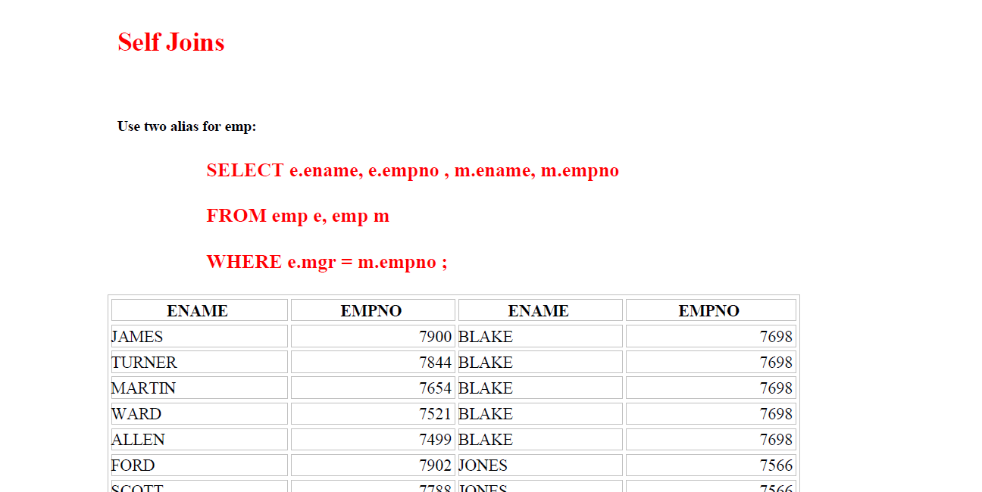

Slide 45
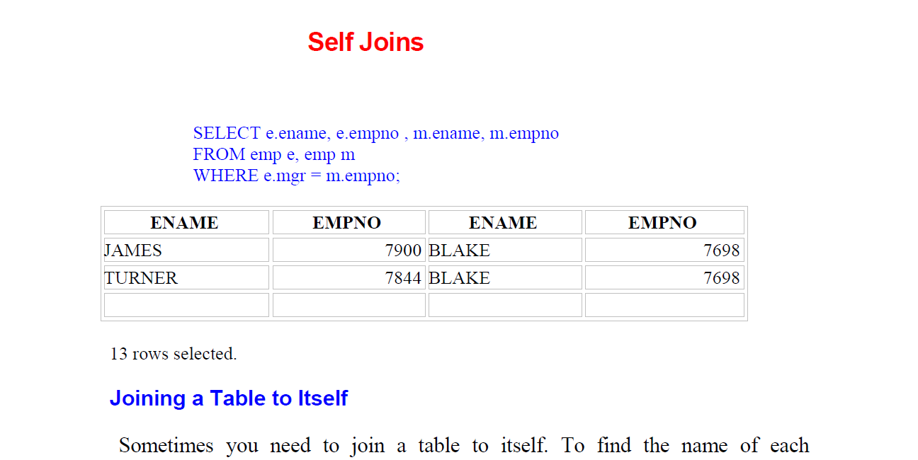

Slide 46
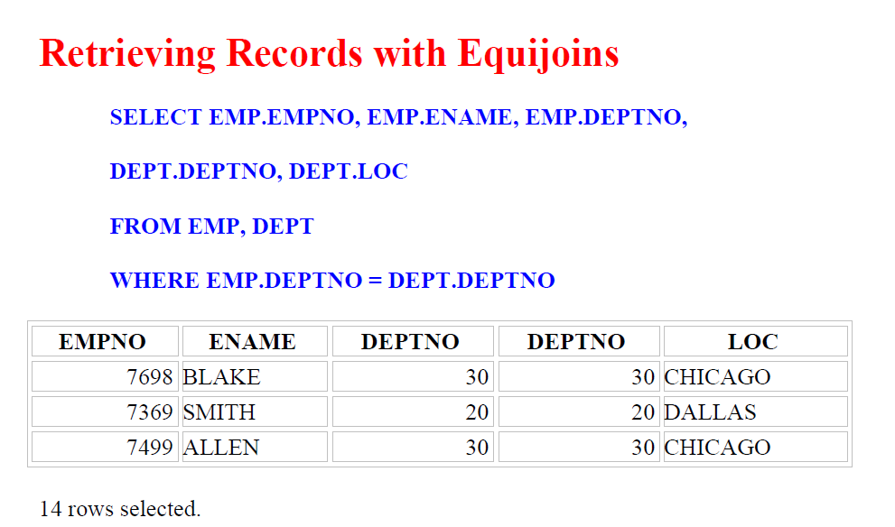

Slide 47
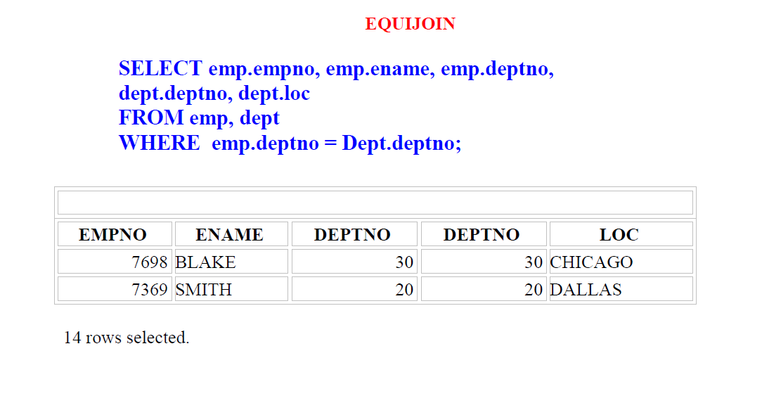

Slide 48
